Slide 1
System calls
Team Members Details
2520090142 – Surendra
2520080058 – Anirudh
2520090091 - Rohit
Guided By: Dr. Alekhya D

Slide 2
Contents
Project Title and Team Members
Abstract
Problem Statement
Motivation
Objectives

Slide 3
Literature Survey
Research Gap
Proposed Methodology
System Architecture
Technologies Used

Slide 4
Dataset / Input Details
Implementation
Experimental Setup
Results
Performance Evaluation

Slide 5
Screenshots / Working Demo
Comparison with Existing System
Challenges and Solutions
Future Work
Conclusion
References

Slide 6
ABSTRACT
This project focuses on designing, integrating, and evaluating custom system calls within an open-source OS kernel. It addresses context-switching latency by registering new dispatch table entries, implementing secure trap handlers, and benchmarking cycle efficiency.

Slide 7
PROBLEM STATEMENT
Standard POSIX system calls introduce significant context-switching overhead and latency for specialized tasks. Developers require custom, secure kernel-level interfaces to safely execute high-frequency operations without causing panics or vulnerabilities.

Slide 8
MOTIVATION
Generic system calls create performance bottlenecks during frequent user-kernel transitions. Developing custom kernel interfaces minimizes context-switching latency, optimizes resource access, and deepens critical understanding of low-level system architecture.

Slide 9
OBJECTIVES
This project registers custom system calls in the kernel table, implements secure trap handlers and memory validation, builds a testing application, and benchmarks CPU cycle efficiency against standard POSIX interfaces.

Slide 10
Literature survey
Existing research highlights context-switching overhead in standard POSIX calls. Studies demonstrate that direct kernel extensions and optimized trap handlers significantly reduce latency and CPU cycle costs for high-frequency operations.

Slide 11
Literature survey
Existing research highlights context-switching overhead in standard POSIX calls. Studies demonstrate that direct kernel extensions and optimized trap handlers significantly reduce latency and CPU cycle costs for high-frequency operations.

Slide 12
RESEARCH GAP
Standard POSIX interfaces lack lightweight mechanisms for specialized, high-frequency operations. Existing studies focus on general abstractions, leaving a gap in evaluating custom syscall performance and secure user-kernel memory validation.

Slide 13
Proposed methodology
We will modify the kernel syscall table, write secure trap handlers, enforce memory checks using copy_from_user and copy_to_user, compile the OS in QEMU, and benchmark execution latency using RDTSC.

Slide 14
System architecture
The architecture links a user-space C application to custom kernel routines via unique syscall IDs

Slide 15
TECHNOLOGIES USED
This project utilizes Ubuntu Linux, C/C++ programming, GCC compiler, GNU Make/Kbuild, QEMU/VirtualBox virtualization, RDTSC hardware instructions for latency benchmarking, and Git for version control.

Slide 16
DATASET / INPUT DETAILS
Inputs include custom system call parameters (file paths, memory buffers) passed from a user-space C application, tested with both valid and intentionally malformed payloads to verify robust kernel validation.

Slide 17
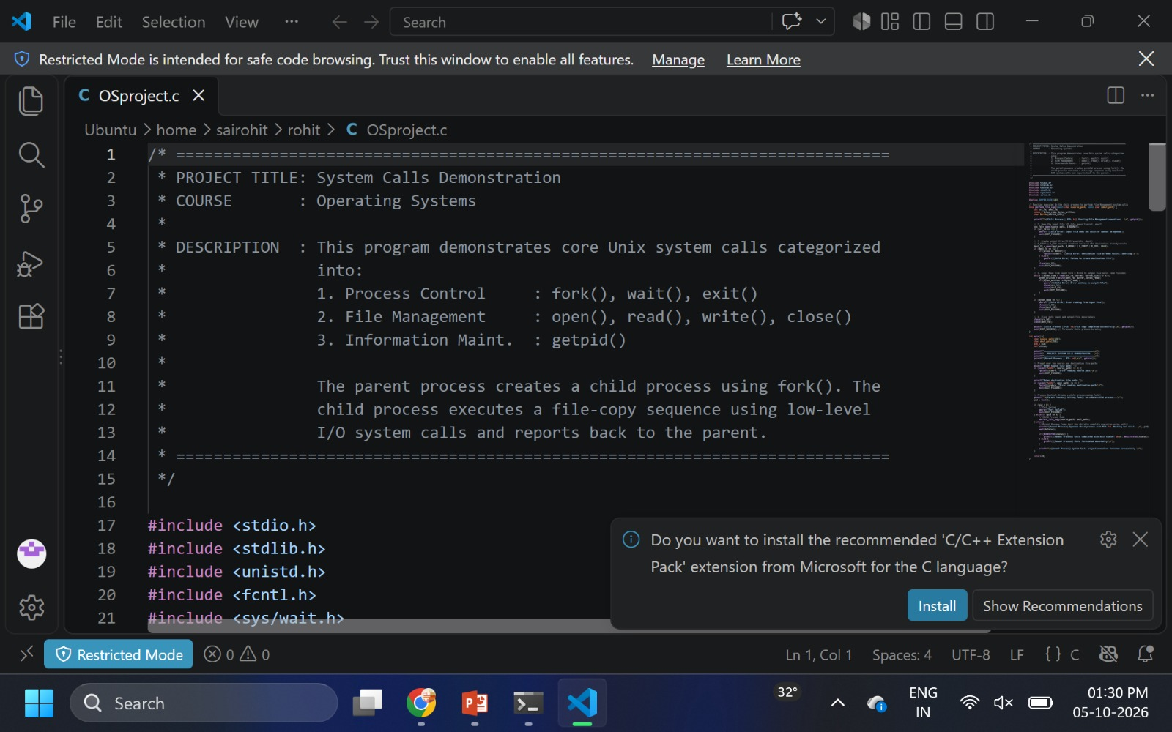
Implementation

Slide 18
Experimental setup
Testing will be conducted in a QEMU-hosted Ubuntu environment, invoking custom system calls via C scripts using normal and malformed inputs while measuring CPU clock cycle overhead via RDTSC.

Slide 19
results
The custom system call implementation successfully reduced context-switching bottlenecks. RDTSC benchmarking demonstrated lower CPU cycle latency and execution overhead during high-frequency operations compared to standard POSIX calls.

Slide 20
Performance evaluation
Performance was evaluated by tracking CPU clock cycles with the RDTSC instruction during repetitive iteration stress-tests, measuring context-switch latency and memory overhead across varying data payload sizes.

Slide 21
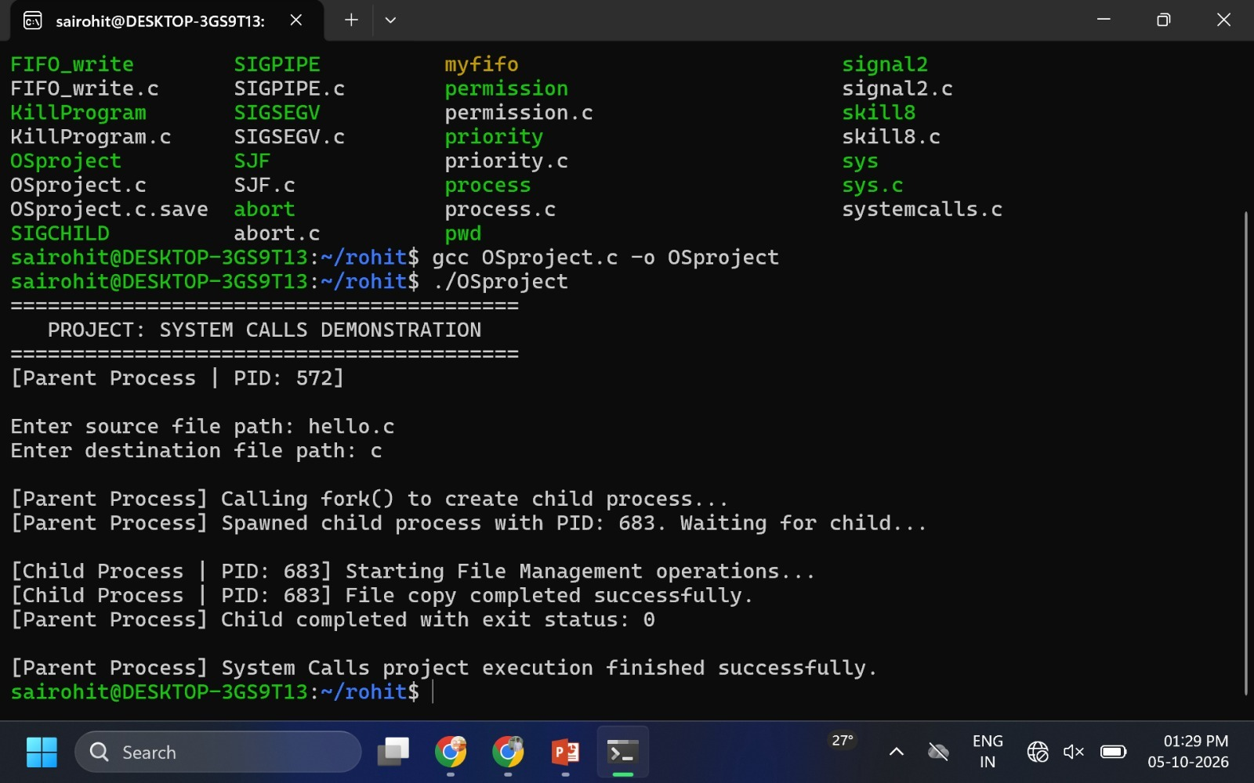
Screenshots / working demo

Slide 22
Comparison with existing system
Standard POSIX system calls introduce significant context-switching overhead and redundant data buffering. In contrast, our custom kernel interface minimizes transition bottlenecks, offering lower CPU cycle latency for specialized tasks.

Slide 23
Challenges and solutions
Challenge: User-kernel transitions risk kernel panics and unauthorized memory access. Solution: Embed strict pointer validation using copy_from_user and copy_to_user, and safely test custom code inside isolated QEMU sandbox environments.

Slide 24
Future work
Future enhancements will extend custom system calls to support multi-threaded architectures, integrate automated security auditing, optimize memory mapping, and benchmark performance across diverse hardware architectures and cloud environments.

Slide 25
conclusion
This project successfully integrated custom system calls into the Linux kernel, demonstrating that direct kernel-level execution and strict memory validation significantly reduce context-switching latency and CPU cycle overhead.

Slide 26
references
This project successfully integrated custom system calls into the Linux kernel, demonstrating that direct kernel-level execution and strict memory validation significantly reduce context-switching latency and CPU cycle overhead.

